Slide 1


Retail Proof of Concept
Demonstrate the flexibility of the Talend DI and ESB Products
Model a retail company with satellite branches returning data to a central system
Simulate regular communication polling
Centralised information is used to populate other systems
Rudimentary stock control mechanism will be applied
All processes occur with minimal intervention
powered by

Slide 2

Design Constraints Sales Generation
Eight stores and twelve products will be used in this example
A simulation engine will be used to create the local sales data
Each poll will generate between 3 and 12 orders per store
Each order will have between 1 and 8 products
Each product has a sales quantity between 1 and 4 items
powered by

Slide 3
Retail POC
Additional Information
My Wordpress Site
John Tucker Integration
HTTP://3.8.7.77
Talend Forge
https://www.talendforge.org/
Many Other Web Resources
Talend, Apache Camel, MySQL, JMS, Karaf etc
powered by

Slide 4

Information Talend Routes
A Talend Route models data flow.
Built on the Apache Camel framework
Uses Java Message Service (JMS) technology
Operations are termed Mediation.
Calls Talend Jobs to transform data.
powered by

Slide 5

Information Apache Camel
Open Source framework for data flow and control.
Top level Apache project
Implements the book Enterprise Integration Patterns
Uses routes to connect end points
Talend ESB implements the common end points
All others can be accessed via a generic placeholder
powered by
This Photo by Unknown Author is licensed under CC BY-NC

Slide 6

Information JMS
Encapsulates data in a message wrapper
Message has a body containing data and a header with metadata
Allows data to be moved through various end points without the data being directly visible.
Guarantees message used not more than once
Robust but does not guarantee delivery
Persistence requires a broker such as ActiveMQ
powered by

Slide 7

Information Talend Jobs
A Talend Job Transforms Data.
Built in Native Talend Code
Belong To ETL (Extract Transform Load) Layer
Operations are termed Integration.
Can Run Standalone of From a Route.
powered by

Slide 8
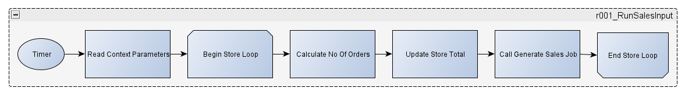
Retail POC
Talend Run Sales Input Route
Talend Route to loop through stores and call Job to generate sales data
Initiated by a timer
Configured through context parameters
powered by

Slide 9
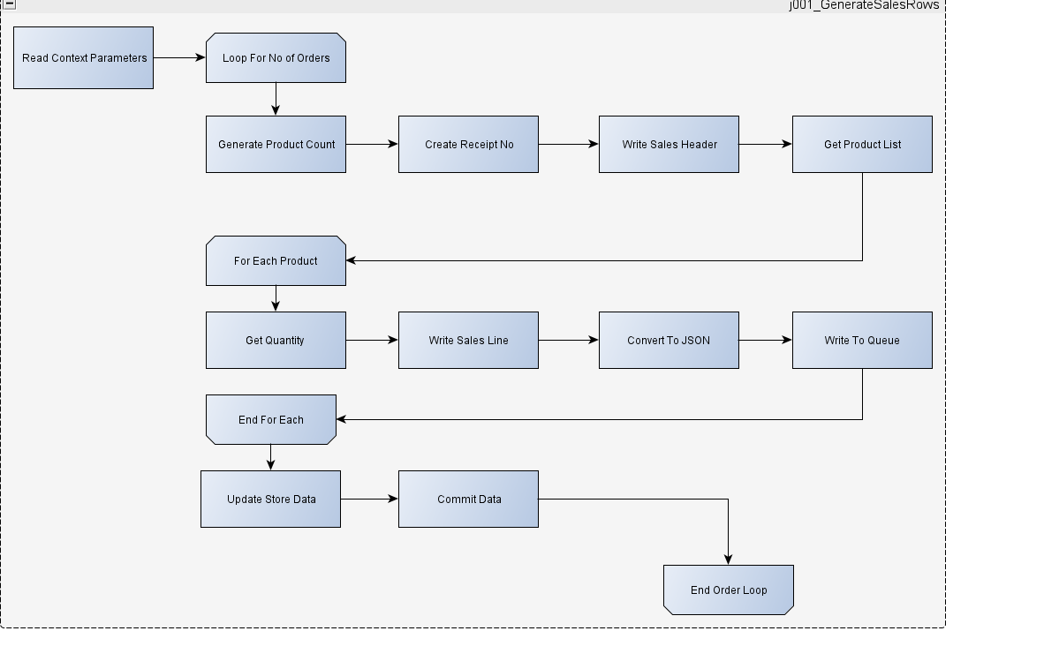
Retail POC
Talend Generate Sales Job
Gets order count from route
Loops for each order
Write header with unique receipt number
Generates random product list
Creates lines for each product with random quantities
Saves in DB
Writes to queue
powered by

Slide 10


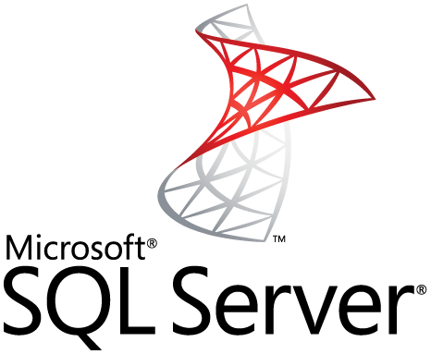




Store 1
Retail POC
Store 8
Stock Maintenance
Suppliers
Store 2
Financial Ledger
Finance
Central Database
Store 7
Store 3
Data Warehouse
SSAS Cube
SSRS Report
Analytics
Store 6
Store 4
Sales Analysis
NoSql
Database
Store 5

Slide 11
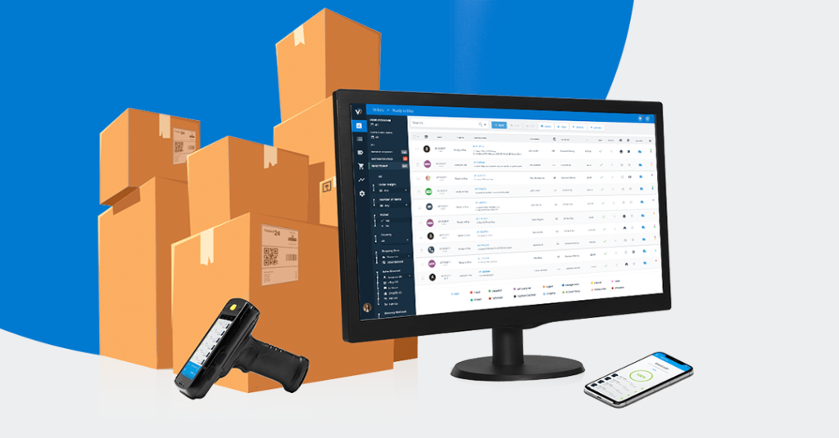
Design Constraints Stock Maintenance
Each product will have a minimum stock level and order quantity
When minimum level is reached a purchase order will be e-mailed to the supplier
Each poll will generate between 3 and 12 orders per store
Each order will have between 1 and 8 products
Each product has a sales quantity between 1 and 4
powered by

Slide 12
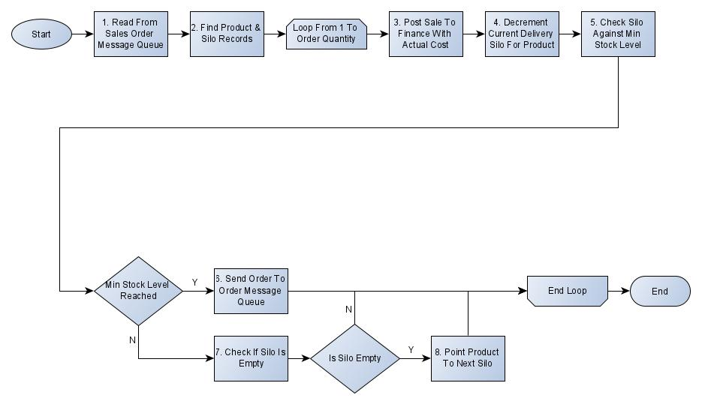
Retail POC
Stock Control Mechanism
powered by

Slide 13
Design principle Stock Maintenance
Order will be e-mailed to supplier when minimum level is reached
Supplier will acknowledge with a csv file including unit cost
Cost will be the base price from product plus or minus up to 25%
New stock batches are placed in a virtual silo with the assigned price
Orders are fulfilled from the current silos
Once a silo is empty the next one for that product becomes the current silo
powered by

Slide 14
Retail POC
Talend job & route relationships
Routes
Called, Standalone or JMS Jobs
REST or SOAP Jobs
Child Jobs
r001_RunSalesInput
j001_GenerateSalesRow
j007_RESTGetStores
r002_RunOrderBookIn
j002_MOMBookInSupplierOrder
r003_UpdateReportData
j003_ReportDataUpdate
j004_MOMCheckProductLevel
j009_RESTProductAPI
j010_RESTProductSale
j006_MOMMongoDBWrite
j011_RESTMailService
j015_SubPOPMail
j008_GetSupplierEMails
j012_RESTSalesByRegionConsumer
j016_MongoDBReadSales
j013_SOAPSalesByRegion
j014_SOAPAllSalesByRegion
powered by

Slide 15
Retail POC
Talend job/route to ActiveMQ links
Queue:SalesLog
j001_GenerateSalesRow
j004_MOMCheckProductLevel
Queue:NoSQLSalesLog
j006_ MOMMongoDBWrite
Queue:SupplierOrderConfirmation
r002_RunOrderBookIn
j002_MOMBookInSupplierOrder
powered by

Slide 16
Retail POC
Talend job to database table connection - Part 1
Jobs
Stored Procedures
Tables
tbproduct
j001_GenerateSalesRow
tbsale
tbsaleline
j004_MOMCheckProductLevel
ProcessSales
tbstocksilo
j007_RESTGetStores
tbstore
powered by

Slide 17
Retail POC
Talend job to database table connection - Part 2
Jobs
Stored Procedures
Tables
tbproduct
CreateProductSilo
tbproductsupplier
GetProductSupplier
ProductData
j009_RESTProductAPI
AssignedSuppliers
Create Product Silo
tbstocksilo
AddSuppliers
CheckProductSupplierValues
AssignedSuppliers
AllSuppliers
DeleteSupplier
tbsupplier
RaisePurchaseOrder
CheckAssignedSupplier
tbpurchaseorder
powered by
RaisePurchaseOrder

Slide 18
Retail POC
Talend job to database table connection - Part 3
Jobs
Stored Procedures
Tables
Read
tbProductSale
j010_RESTProductSale
Write
uspInsertProductSale
tbsale
j013_SOAPSalesByRegion
tbsaleline
GetSalesByRegion
tbstore
j014_SOAPAllSalesByRegion
AllSalesByRegion
tbproduct
powered by

Slide 19
Retail POC
Talend job to nosql database collection
Jobs
Collection
j006_MOMMongoDBWrite
saleslog
j016_MongoDBReadSales
powered by

